Slide 1
Attempt 1
Parameters:
M | K | Threshold | Tolerance
5 | 10 | 20 | 10
Results:
Steps | Optimal Profit | Optimal Seats | Optimal Arrangement | Runtime [s]
1) Greedy | ≈$12,741 | [211, 229] | 208 seats: [0 32 17 12 9] 229 seats: [0 35 19 13 10] | 106.613
2) SA | ≈$13,415 | [218, 225] | 220 seats: [0 21 14 19 12] 225 seats: [0 25 14 12 17] | 1857.895
Iterations:
a_{k}: 200.0000 200.0000 200.0000 200.0000 211.1486 218.0362 218.0362
b_{k}: 323.6000 276.4000 247.2152 229.1848 229.1848 229.1848 224.9260

Slide 2
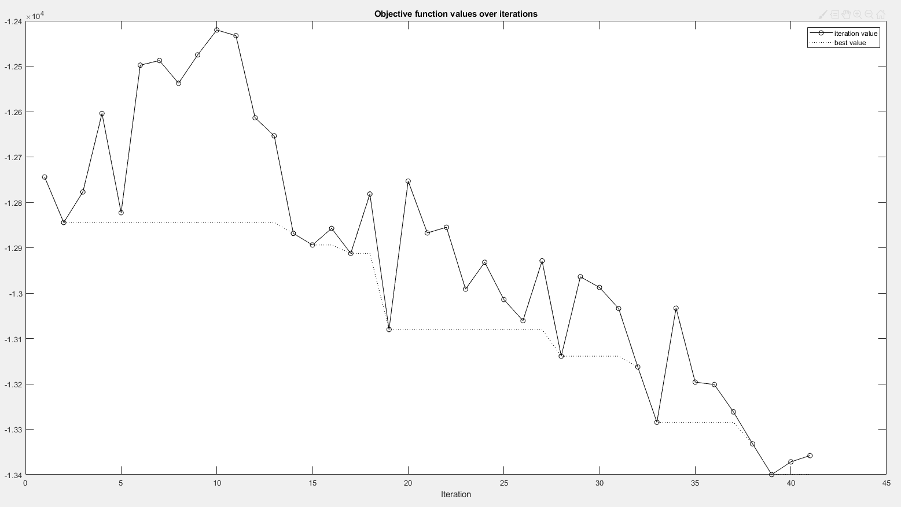
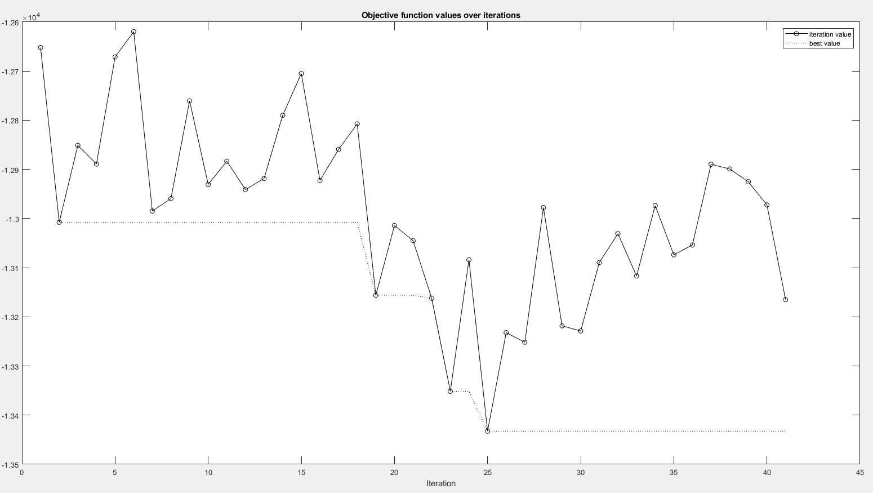
Attempt 1
Objective values over iterations
Notes:
Forgot the append the same values to the list when the algorithm did not find a better solution or did not accept a worse solution. But we can still see that the current setting isn’t enough to observe the plateau.

Slide 3
Attempt 2
Parameters:
M | K | Threshold | Tolerance
10 | 10 | 20 | 10
Results:
Steps | Optimal Profit | Optimal Seats | Optimal Arrangement | Runtime [s]
1) Greedy | ≈$12,553 | [218, 236] | 220 seats: [0 34 18 12 10] 231 seats: [0 36 19 13 10] | 91.702
2) SA | ≈$13,203 | [218, 225] | 220 seats: [0 39 10 13 12] 220 seats: [0 16 19 14 15] | 3792.260
Iterations:
a_{k}: 200.0000 200.0000 200.0000 218.0362 218.0362 218.0362 218.0362
b_{k}: 323.6000 276.4000 247.2152 247.2152 236.0688 229.1848 224.9247

Slide 4
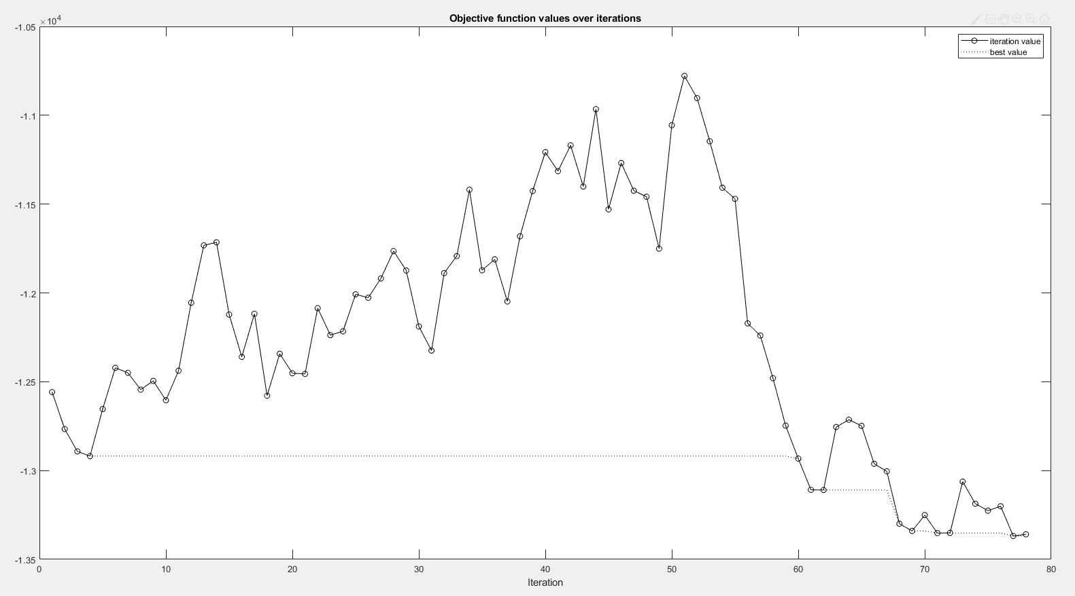
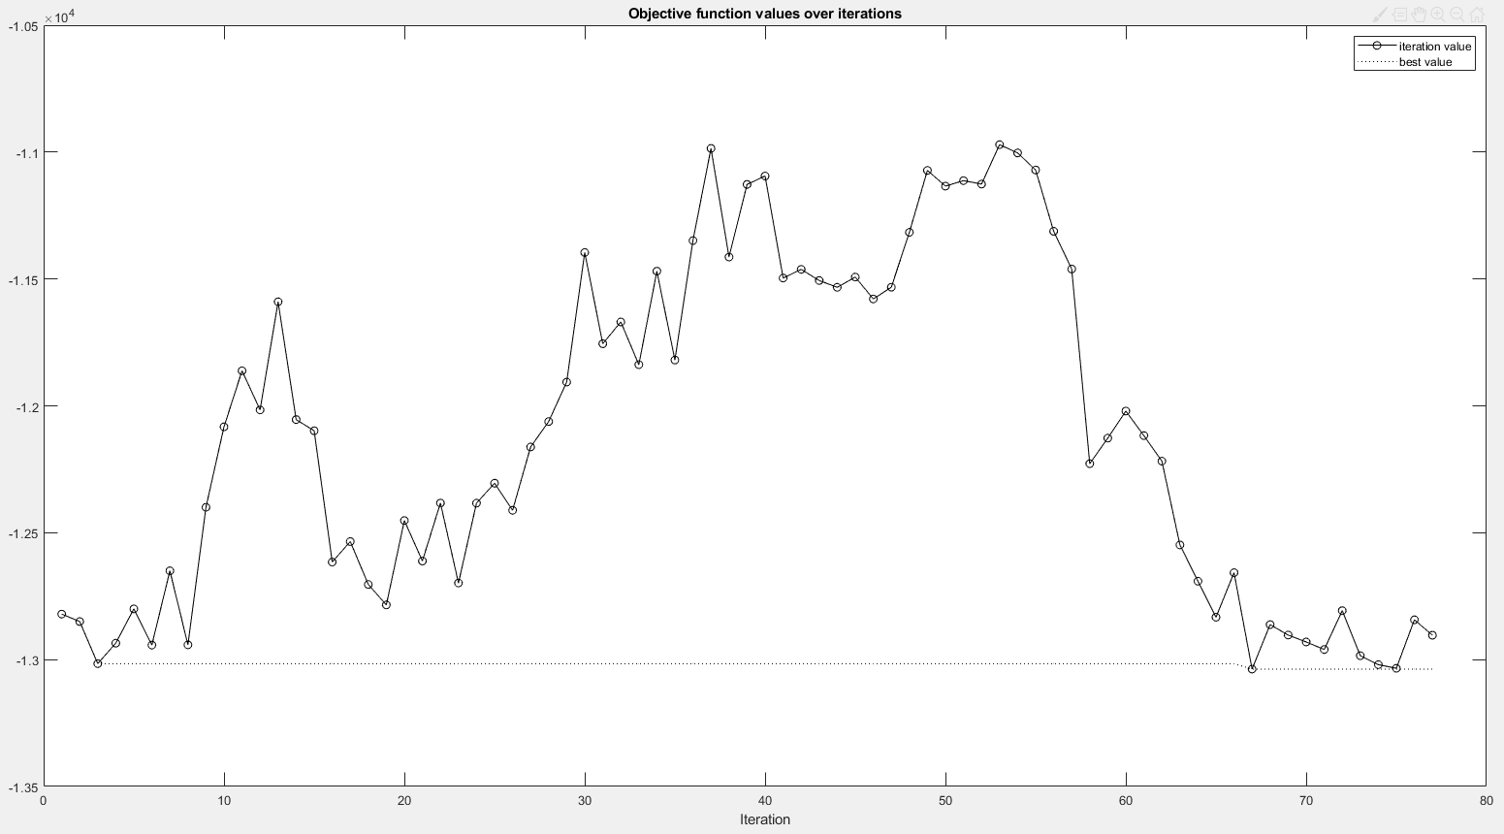
Attempt 2
Objective values over iterations
Notes:
Accepting worse solutions too frequently, so perhaps we should increase M and/or decrease D

Slide 5
Attempt 3
Parameters: (D = 100 from 500)
M | K | Threshold | Tolerance
20 | 10 | 20 | 10
Results:
Steps | Optimal Profit | Optimal Seats | Optimal Arrangement | Runtime [s]
1) Greedy | ≈$12,851 | [200, 218] | 202 seats: [0 31 17 11 9] 220 seats: [0 34 18 12 10] | 92.568
2) SA | ≈$13,531 | [211, 218] | 218 seats: [0 22 18 10 16] 218 seats: [0 24 9 17 15] | 8503.890
Iterations:
a_{k}: 200.0000 200.0000 200.0000 200.0000 200.0000 206.8898 211.1486
b_{k}: 323.6000 276.4000 247.2152 229.1848 218.0362 218.0362 218.0362

Slide 6
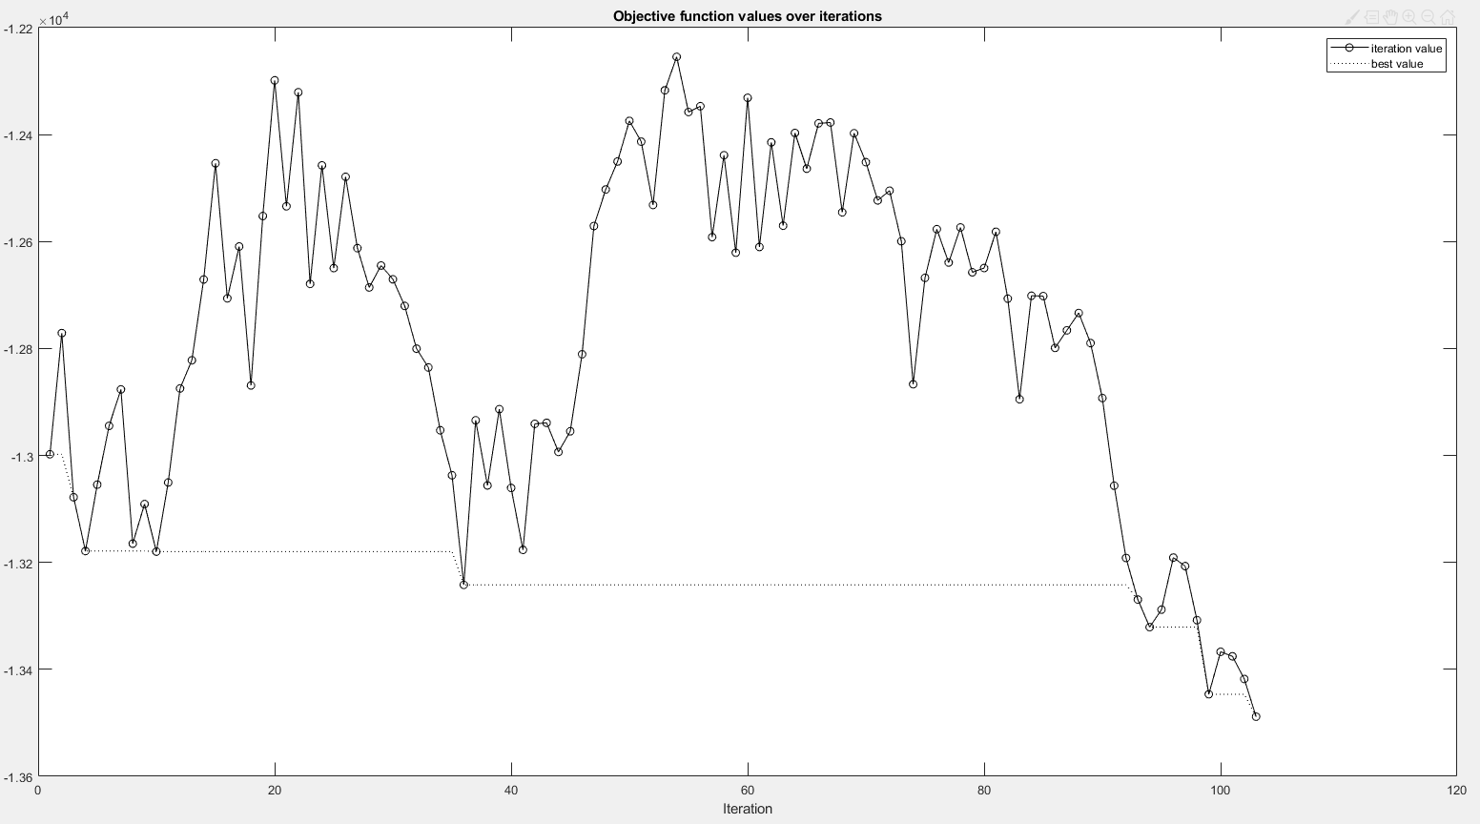
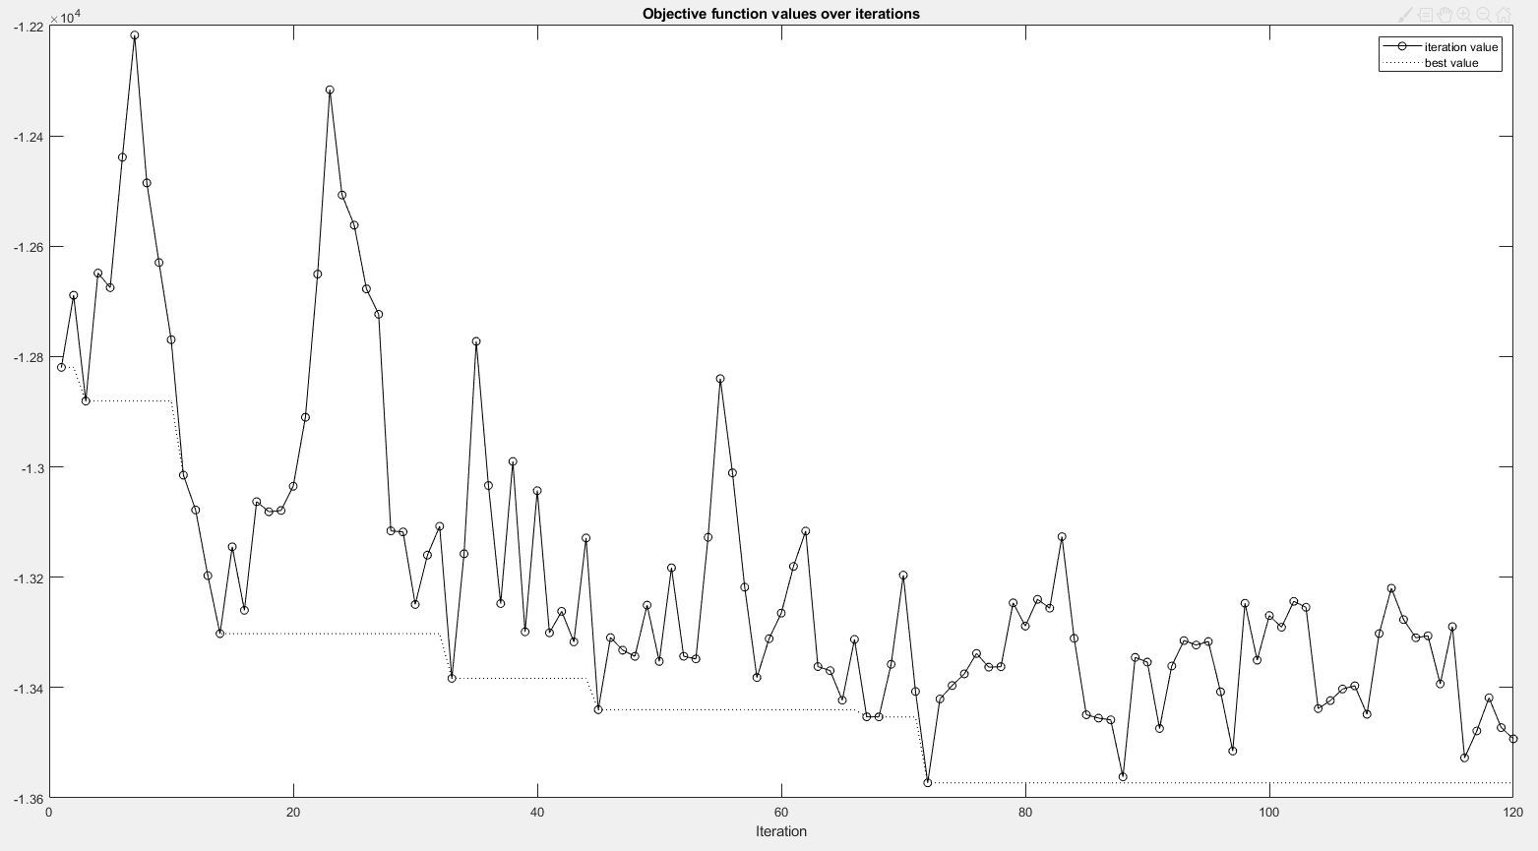
Attempt 3
Objective values over iterations
Notes:
Looks promising… maybe reduce tolerance and append same objective values whenever no better solutions are found and worse solutions are not accepted to see if the progress has truly settled down.

Slide 7
Attempt 4
Parameters: (D = 100)
M | K | Threshold | Tolerance
20 | 10 | 20 | 10
Results:
Steps | Optimal Profit | Optimal Seats | Optimal Arrangement | Runtime [s]
1) Greedy | ≈$12,832 | [211, 229] | 208 seats: [0 32 17 12 9] 229 seats: [0 35 19 13 10] | 90.665
2) SA | ≈$13,480 | [222, 229] | 225 seats: [0 25 15 10 18] 229 seats: [0 22 18 14 15] | 8378.301
Iterations:
a_{k}: 200.0000 200.0000 200.0000 200.0000 211.1486 218.0362 222.2950
b_{k}: 323.6000 276.4000 247.2152 229.1848 229.1848 229.1848 229.1848

Slide 8
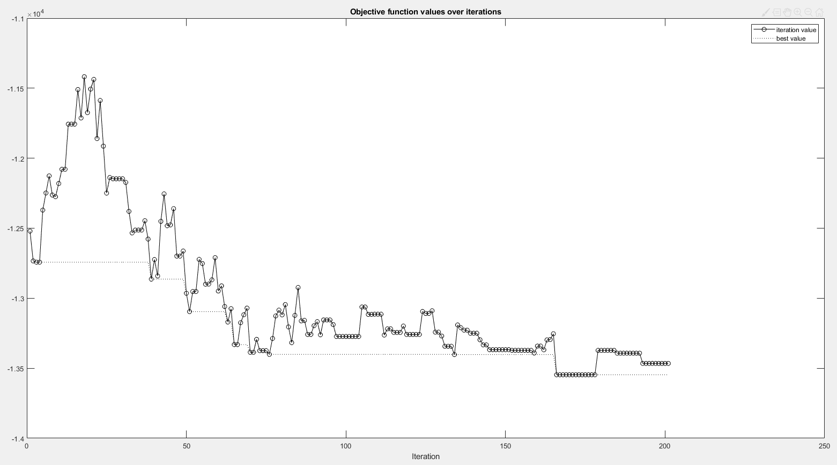
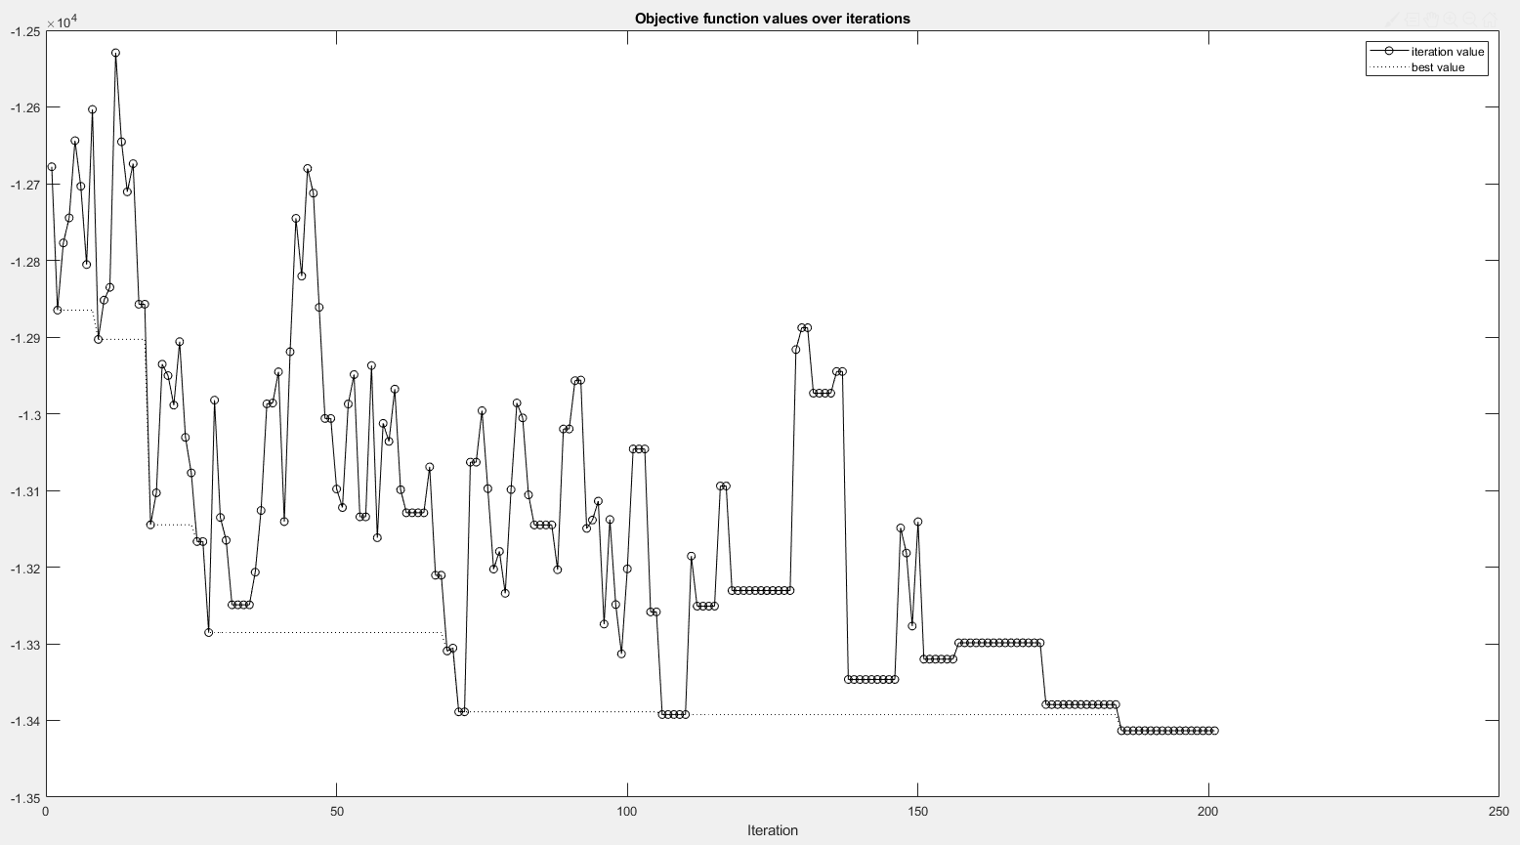
Attempt 4
Objective values over iterations

Slide 9
Attempt 5
Parameters: (D = 100)
M | K | Threshold | Tolerance
20 | 10 | 20 | 5
Results:
Steps | Optimal Profit | Optimal Seats | Optimal Arrangement | Runtime [s]
1) Greedy | ≈$12,832 | [211, 229] | 208 seats: [0 32 17 12 9] 229 seats: [0 35 19 13 10] | 75.653
2) SA | ≈$13,486 | [222, 227] | 223 seats: [0 25 5 17 18] 225 seats: [0 25 15 10 18] | 12431.216
Iterations:
a_{k}: 200.0000 200.0000 200.0000 200.0000 211.1486 218.0362 222.2950 222.2950
b_{k}: 323.6000 276.4000 247.2152 229.1848 229.1848 229.1848 229.1848 226.5529

Slide 10
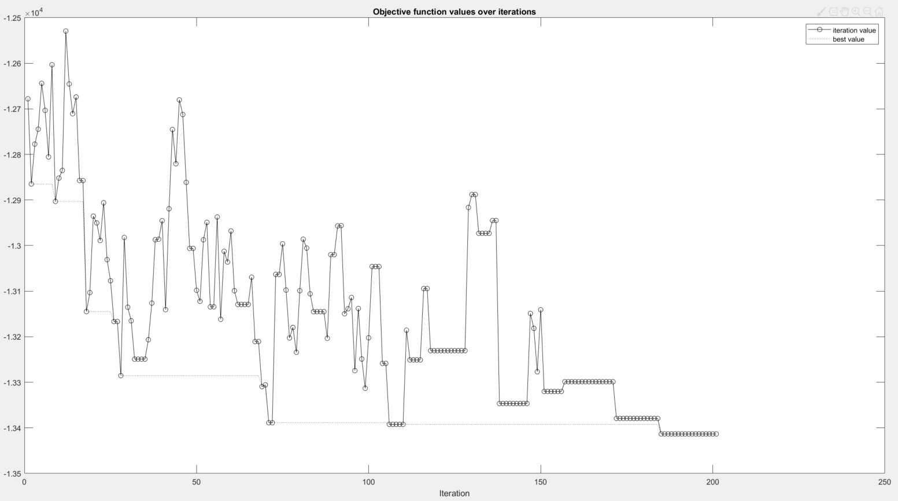
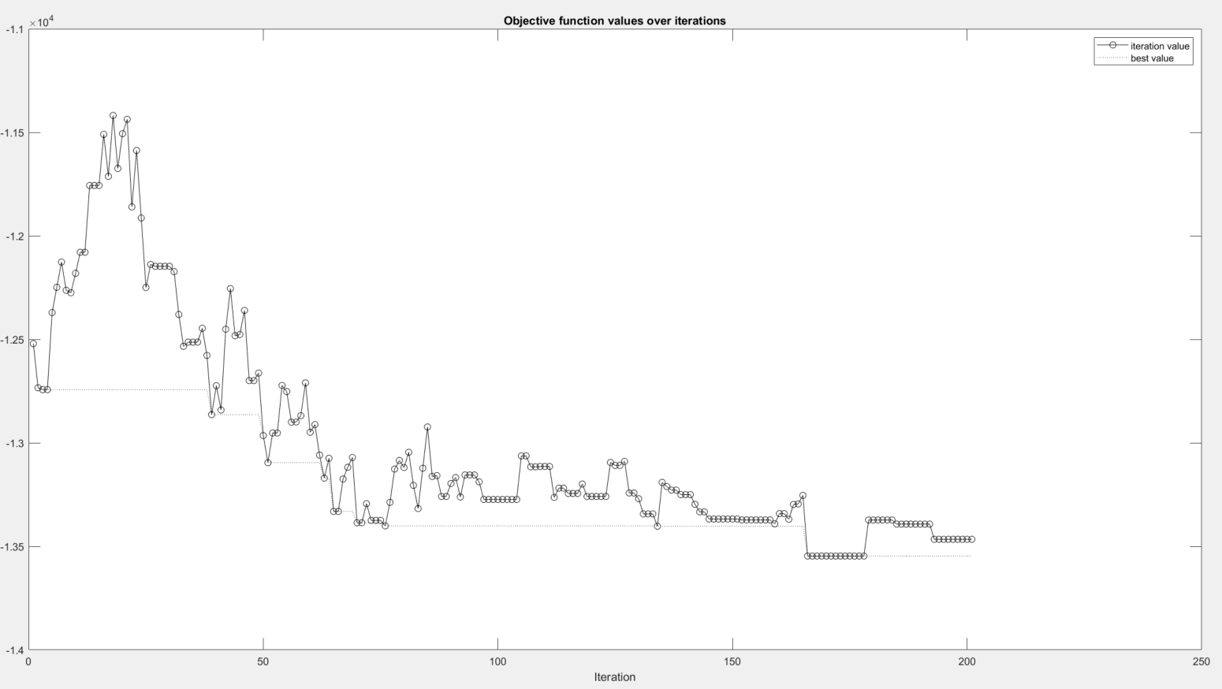
Attempt 5
Objective values over iterations

Slide 11
Attempt 6
Parameters: (D = 100)
M | K | Threshold | Tolerance
20 | 10 | 50 | 10
Results:
Steps | Optimal Profit | Optimal Seats | Optimal Arrangement | Runtime [s]
1) Greedy
2) SA
Iterations:
a_{k}:
b_{k}:

Slide 12
Attempt 6
Objective values over iterations

Slide 13
Attempt 7
Variable Neighborhood Search
V1 | V2 | Threshold | Tolerance
SM1 | SM2 | 50 | 5
Results:
Steps | Optimal Profit | Optimal Seats | Optimal Arrangement | Runtime [s]
1) Greedy | ≈$12,773 | [200, 247] | 202 seats: [0 31 17 11 9] | 49.361
2) VNS | ≈$13,744 | [204, 208] | 204 seats: [0 19 14 11 16] | 4101.612
Iterations:
a_{k}: 200.0000 200.0000 200.0000 200.0000 200.0000 200.0000 204.2588 204.2588
b_{k}: 323.6000 276.4000 247.2152 229.1848 218.0362 211.1486 211.1486 208.5167

Slide 14
Attempt 8 (settings are identical to attempt 7)
Variable Neighborhood Search
V1 | V2 | Threshold | Tolerance
SM1 | SM2 | 50 | 5
Results:
Steps | Optimal Profit | Optimal Seats | Optimal Arrangement | Runtime [s]
1) Greedy | ≈$12,823 | [200, 247] | 202 seats: [0 31 17 11 9] | 47.578
2) VNS | ≈$13,774 | [204, 208] | 204 seats: [0 22 16 13 12] | 3813.415
Iterations:
a_{k}: 200.0000 200.0000 200.0000 200.0000 200.0000 200.0000 204.2588 204.2588
b_{k}: 323.6000 276.4000 247.2152 229.1848 218.0362 211.1486 211.1486 208.5167

Slide 15
Attempt 9 (settings are identical to attempt 7)
Variable Neighborhood Search
V1 | V2 | Threshold | Tolerance
SM1 | SM2 | 50 | 5
Results:
Steps | Optimal Profit | Optimal Seats | Optimal Arrangement | Runtime [s]
1) Greedy | ≈$12,823 | [200, 247] | 202 seats: [0 31 17 11 9] | 48.641
2) VNS | ≈$13,774 | [204, 208] | 204 seats: [0 22 16 13 12] | 4282.033
Iterations:
a_{k}: 200.0000 200.0000 200.0000 200.0000 200.0000 200.0000 204.2588 204.2588
b_{k}: 323.6000 276.4000 247.2152 229.1848 218.0362 211.1486 211.1486 208.5167

Slide 16
Attempt 10 (settings are identical to attempt 7)
Variable Neighborhood Search
V1 | V2 | Threshold | Tolerance
SM1 | SM2 | 50 | 5
Results:
Steps | Optimal Profit | Optimal Seats | Optimal Arrangement | Runtime [s]
1) Greedy | ≈$12,823 | [200, 247] | 202 seats: [0 31 17 11 9] | 52.147
2) VNS | ≈$13,774 | [204, 208] | 204 seats: [0 22 16 13 12] | 5035.692
Iterations:
a_{k}: 200.0000 200.0000 200.0000 200.0000 200.0000 200.0000 204.2588 204.2588
b_{k}: 323.6000 276.4000 247.2152 229.1848 218.0362 211.1486 211.1486 208.5167

Slide 17
Attempt 11 (different seating policy: reserve tables for customer groups of size 5)
Variable Neighborhood Search
V1 | V2 | Threshold | Tolerance
SM1 | SM2 | 50 | 5
Results:
Steps | Optimal Profit | Optimal Seats | Optimal Arrangement | Runtime [s]
1) Greedy | ≈$13,157 | [200, 247] | 202 seats: [0 31 17 11 9] | 59.722
2) VNS | ≈$13,921 | [200, 204] | 202 seats: [0 22 11 15 13] | 4402.509
Iterations:
a_{k}: 200 200 200 200 200 200 200 200
b_{k}: 323.6000 276.4000 247.2152 229.1848 218.0362 211.1486 206.8898 204.2588

